Slide 1
Post- Traumatic Endophthalmitis
Presenter Dr. Hin Dan ,
IU resident

Slide 2
Contents
Introduction
Pathophysiology
Diagnosis
Differential diagnosis
Management
Case Report

Slide 3
I. Introduction
Endophthalmitis : a serious intraocular inflammatory reaction, involving both the posterior and anterior chambers is attributable to bacterial or fungal infection, marked by inflammation of intraocular fluid and tissues.
( will Eye Manual and AAO Section 9 Intraocular inflammation and uveitis )
General categories : (et al)
Postoperative endophthalmitis ( acute, delayed-onset, Conjunctival filtering- bleb ) 75%
Posttraumatic endophthalmitis 20%
Endogenous endophthalmitis 5%
Miscellaneous noninfectious causes ( sterile uveitis , phacoanaphylactic endophthalmitis, Sympathetic ophthalmia )

Slide 4
I. Introduction
Posttraumatic endophthalmitis
Intraocular infection involving the anterior and posterior segment of the eye after a traumatic open globe injury
The incidence:
12% of eyes with history of penetrating injury without IOFBs.
Higher infection rates - with open globe injury contaminated with organic matter.
( Essex RW, Yi Q, Charles PG, Allen PJ. Post-traumatic endophthalmitis)
Frequency :
Rural penetrating trauma : 30% (boldt HC, Pulido JS, blodi CF et al )

Slide 5
II. Pathophysiology
Infectious agents are introduced at the time of primary open globe injury.
The trauma usually occurs in a non-sterile environment which increases the risk of infection.
Prophylactic antibiotics, used during the repair of the primary injury but the best route and duration of the antibiotics to decrease the risk of endophthalmitis.
Primary prevention
Closure of the open globe wound
Removal of IOFB
Intravitreal antibiotics in cases of IOFB

Slide 6
III. Diagnosis
History
A recent history of penetrating ocular trauma is present
Physical examination
Detailed anterior segment
Posterior segment
A B-scan of the posterior segment may be performed in traumatic eyes suspicious for IOFBs.
Signs
Conjunctival injection +/-Chemosis
Purulent discharge
Mild to moderate anterior chamber reaction
Hypopyon +/- fibrin membranes
Vitritis
Lid edema
Possible periorbital erythema & proptosis

Slide 7
III. Diagnosis
Symptoms
Depend on the virulence of the organism.
Range from mild photophobia and pain to excruciating pain, tearing and decreased vision.
Clinical diagnosis
Pain with hypopyon
Vitritis suggests an infection until proven.
Important to distinguish bacterial from fungal infection since the treatment is different.
Fungal infection may just have mild discomfort.

Slide 8
III. Diagnosis
Diagnostic procedures
B-scan to evaluate for vitreous opacities,
status of retina and choroid
CT scan to evaluate a retained IOFB if the history is suspicious for one.

Slide 9
III. Diagnosis
Laboratory test
Cultures from the wound, vitreous and anterior chamber for identification of aerobic, anaerobic bacteria and fungus.
Order : Gram stain and KOH
70% of vitreous only : positive results.
PCR assays of vitreous for identification of bacterial and fungal.
Blood cultures if septicemia suspected

Slide 10
IV. Differential diagnosis
Post-traumatic non-infectious inflammation
Phacoanaphylactic endophthalmitis

Slide 11
V. Management
General treatment
Emergent admission
Medical therapy
Start systemic antibiotics
vancomycin 1 g q12h and ceftazidime 1g q8h
Clindamycin (300 mg every 8 hours),
amikacin (240 mg q8hr) or gentamycin 80 mg q8hr
in severe cases suspicious for Bacillus (history of IOFB) or anaerobic bacteria.

Slide 12
V. Management
Systemic antifungi
Fluconazole (200 mg BID)
Voriconazole (200mg BID, Intraveinous) fungal infection.
Perform vitreous biopsy
With intravitreal vancomycin 1mg/0.1ml
Ceftazidime 2.25 mg/0.1ml injections in cases where PPV cannot be performed.
Initiate fortified
vancomycin (50 mg/ml) with ceftazidime (100 mg/ml) qh

Slide 13
V. Management
Medical follow up
Hospital 3-5 days
Medical follow up
Clinical follow up
Hypopyon resolves and vitritis improves,
Oral route
Patient is discharged .
fluoroquinolones ( oral) (e.g. Ciprofloxacin 750 mg q 12 hr)
Oral voriconazole (200 mg BID) for fungal infections.
Semiweekly to weekly follow-ups with B-scans are performed until the infection fully resolves.

Slide 14
V. Management
Surgery
(PPV) with intravitreal antibiotics immediatey.
Order : Bacterial and fungal cultures of undiluted vitreous.
Emergent removal of IOFB, if present
Intravitreal vancomycin 1mg/0.1ml and ceftazidime 2.25 mg/0.1ml ,during PPV.
Avoid aminoglycosides, gram(-), high risk of retinal toxicity.

Slide 15
V. Management
Surgery
No IOFB , suspect Bacillus cereus is resistant to cephalosporins.
If Bacillus is suspected, low dose gentamycin 40ug intravitreal injection
Intravitreal corticosteroid (dexamethasone, 0.4 mg / 0.1 ml)
Consider amphotericin (5 ug/0.1 ml) or voriconazole (40-50 µg in 0.1 ml) intravitreal injection if vegetable matter contamination .

Slide 16
V. Management
Surgical follow up
Daily follow-up until improvement
Repeat intravitreal antibiotics in 48-72 hours if not improvement .
Possible repeat vitrectomy for further debridement of the infectious material in the vitreous especially if a limited vitrectomy was performed initially due to media opacity

Slide 17
Complications
Vitreous hemorrhage
Recurrent endophthalmitis
Retinal tears
Retinal detachment
Choroidal Detachment
Drug induced retinal toxicity
Cataract
Secondary glaucoma

Slide 18
Prognosis
Visual prognosis is poor and depends on the virulence of the infecting organism, presence of retinal detachment, timing of treatment, and the extent of initial injury.

Slide 19
VI. Case Report
Post-traumatic
endophthalmitis

Slide 20
VI.Case
A man , 55 years old , farmer , from Prey Veng province.
Arrived & Admitted him at Preah Angdoung Hospital at 10: 10 pm, on May 13th , 2014,
Presented with history – injured by knife on the right eye,during cutting grass at the rice field at 01:45 pm, on the same day.
CC:
Ocular pain
Not be able to see on the right eye.
Blooding

Slide 21
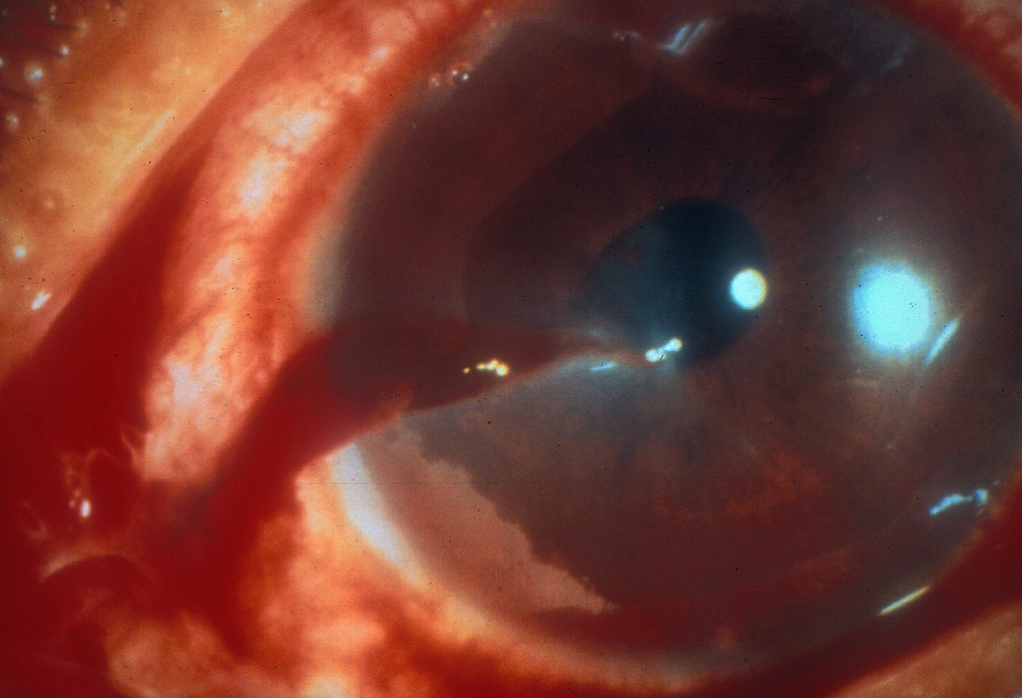
VI. Case
Examination:
GA: NAD
VA: OD: PL ; OG: 6/9
Ocular examination:
EOM: NAD
Eye lid , lid , eye lashes, lid margin : NAD
Conjunctival injection
Corneal perforation with iris prolapsed
AC: flat with hyphema
Pupil not round
lens is opacity ( cataract formation)

Slide 22
VI. Case
Treatment
Indication :
OD : corneal wound repaired
and Intravitreal antibiotic injection.
(3rd generation of cephalosporine 1mg/0.1ml)
With out B- scan
Medical treatment
Antibiotic eyedrop qh
Steroid eyedrop qh
Systemic antibiotic

Slide 23
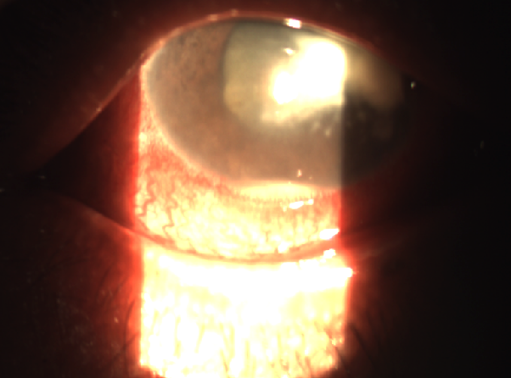
VI. Case
4 months later , he arrived with suture loose,
VA : OD : HM
Ocular pain
Conjunctival injection, Chemosis
moderate anterior chamber reaction
Hypopyon
With out B-Scan
Diagnosis OD: Post traumatic endophthalmitis

Slide 24
VI. Case
Treatment
Indication : OD: Intavitreal injection
(3rd generation of cephalosporine 1mg/0.1ml)
Topical Antibiotic + steroid q 2 h
One month later :
The disease is better
Stop steroid & Antibiotic
One day after that
The disease was relapse

Slide 25
VI. Case
VA : OD : PL
Ocular pain
Conjunctival injection, Chemosis
Moderate anterior chamber reaction , fibrine
Hypopyon , and total fibrin in the AC
Diagnosis : OD : Endophthalmitis

Slide 26
VII. Case
Treatment
Indication : OD: AC wash out and Intavitreal injection (3rd generation of cephalosporine 1mg/0.1ml)
Topical Antibiotic + steroid q2h -
Follow up the day after, the disease is better

Slide 27
References
Surv Ophthalmol 43 ( 3 ) November-December 1998 ( KRESLOFF ET AL.)
http://eyewiki.org/Post-T
Bhagat N, Nagori S, Zarbin MA. Traumatic endophthalmitis. Survey of Ophthalmology. Forthcoming.
Essex RW, Yi Q, Charles PG, Allen PJ. Post-traumatic endophthalmitis. Ophthalmology. 2004 Nov;111(11):2015-22.Meredith TA. Posttraumatic endophthalmitis. Archives of ophthalmology. 1999 Apr;117(4):520-1.
Peyman GA, Lee PJ, Seal DV. Endophthalmitis: Diagnosis and Management. London, England: Taylor & Francis; 2004: pp 90-91.
Soheilian M, Rafati N, Mohebbi MR, Yazdani S, Habibabadi HF, Feghhi M, et al. Prophylaxis of acute posttraumatic bacterial endophthalmitis: a multicenter, randomized clinical trial of intraocular antibiotic injection, report 2. Archives of ophthalmology. 2007
AAO Section 9 Intraocular inflammatory and uveitis
Will Eye Manual

